Slide 1

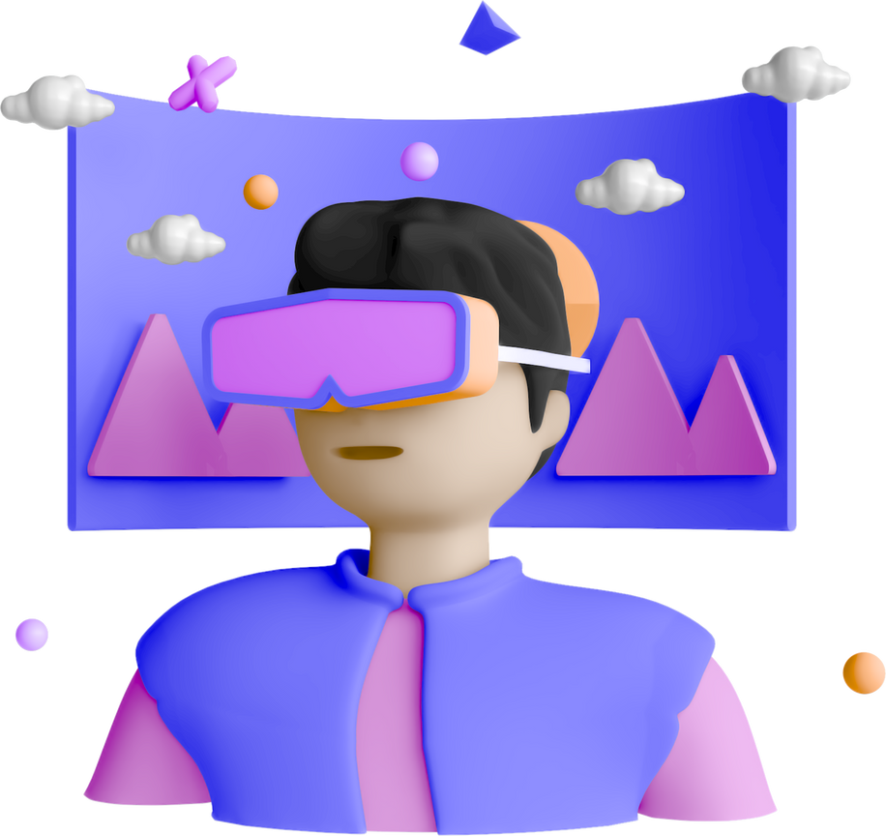
Group 4
CUSTOMER SEGMENTATION & PERSONALIZATION
24MBMB01 - Sivani
24MBMB15 - Sri Harsha
24MBMB16 - Fahim
24MBMB20 - Chetan
24MBMB36 - Usha

Slide 2

Agenda
K Means Clustering
Agglomerative clustering
Recommendation system
Challenges
Real World applications

Slide 3
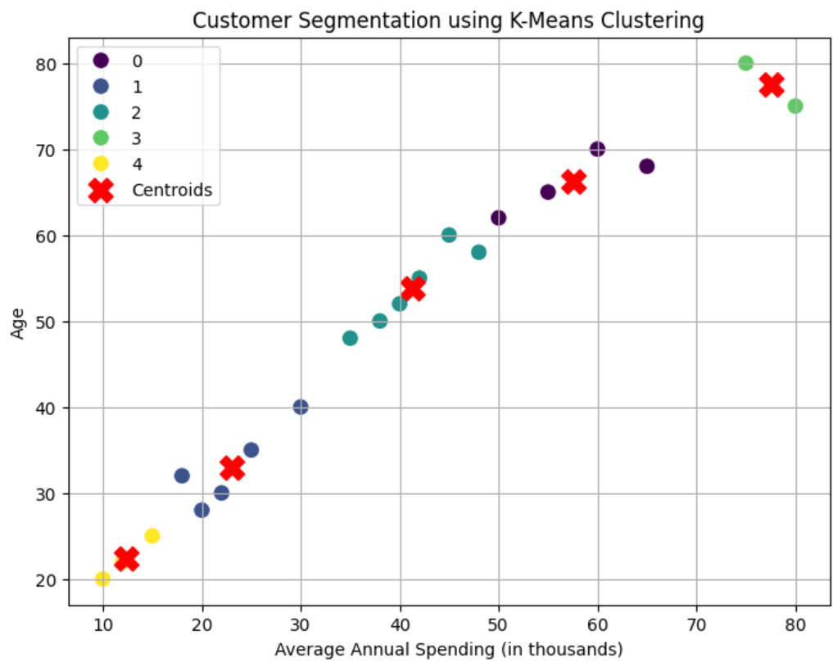
K Means Clustering
What is Customer Segmentation?
Euclidean Distance
Results
Cluster Assignments: Customers grouped into meaningful segments
Cluster Centers: Average age and spending per cluster

Slide 4
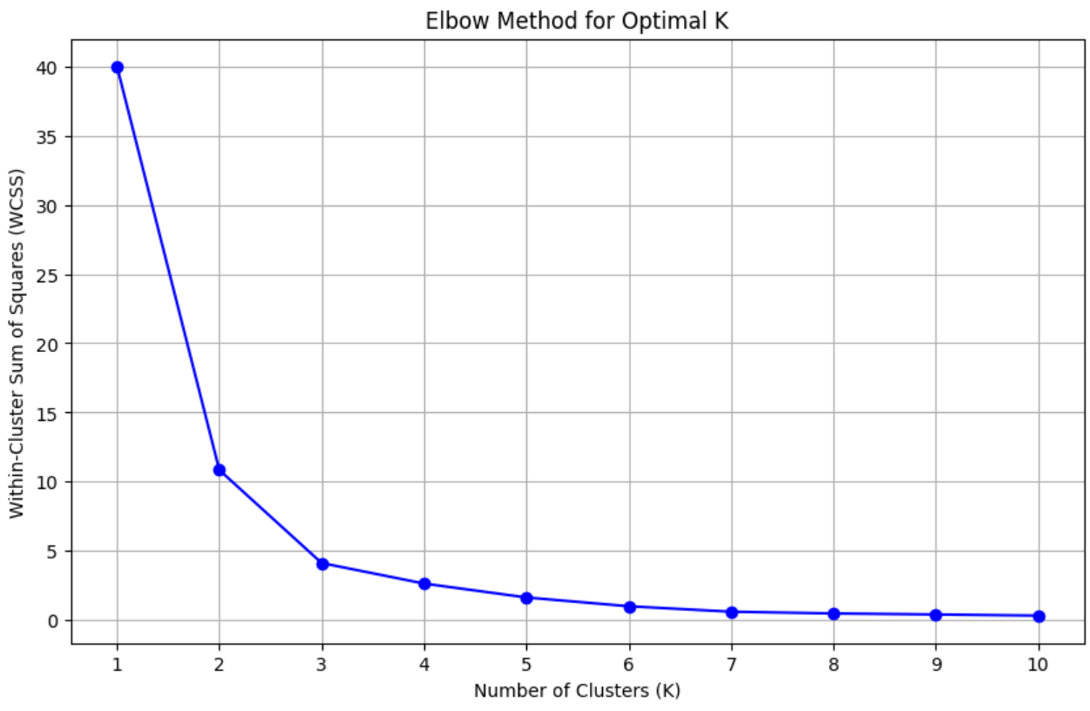
K Means Clustering
The choice of 'K' can significantly impact the results.
ELBOW METHOD -
for optimal clusters
optimal k = 3
Measuring Clustering Quality

Slide 5
Agglomerative clustering
Agglomerative clustering is a bottom-up hierarchical clustering method.
Each data point starts as an individual cluster.
Clusters are iteratively merged based on similarity until one cluster remains or a desired number is reached.
Commonly used linkage criteria:
Single linkage: shortest distance between clusters
Complete linkage: farthest distance
Average linkage: mean distance between all points
Ward’s method: minimizes variance within clusters

Slide 6
A dendrogram is a tree diagram that shows how clusters are formed.
Leaves = individual customers; branches = cluster merges.
The height of each merge shows the distance between clusters.
Cut the tree at a certain height to define the optimal number of customer segments.
Dendrogram

Slide 7
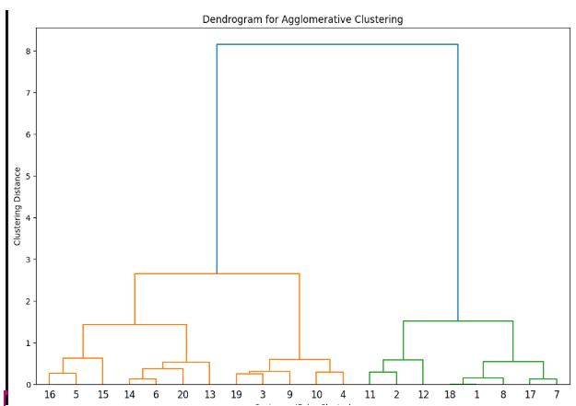

Slide 8
Recommendation system
Content Based Filtering
K-Nearest Neighbors (KNN) - user based
Collaberative Filtering
TF - IDF

Slide 9
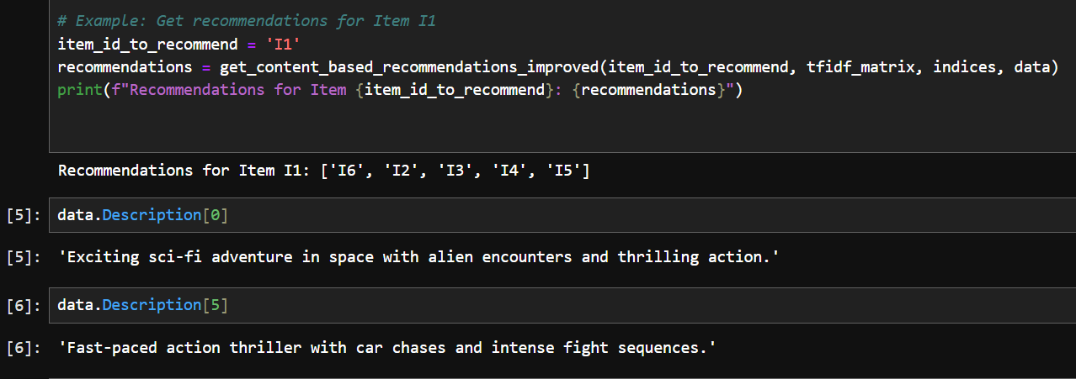
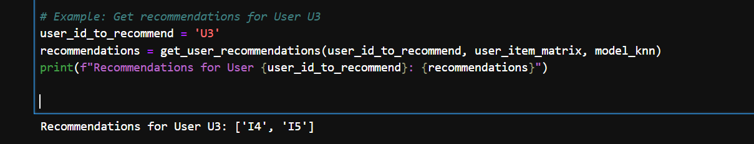
TF - IDF implementation
Knn implementation

Slide 10
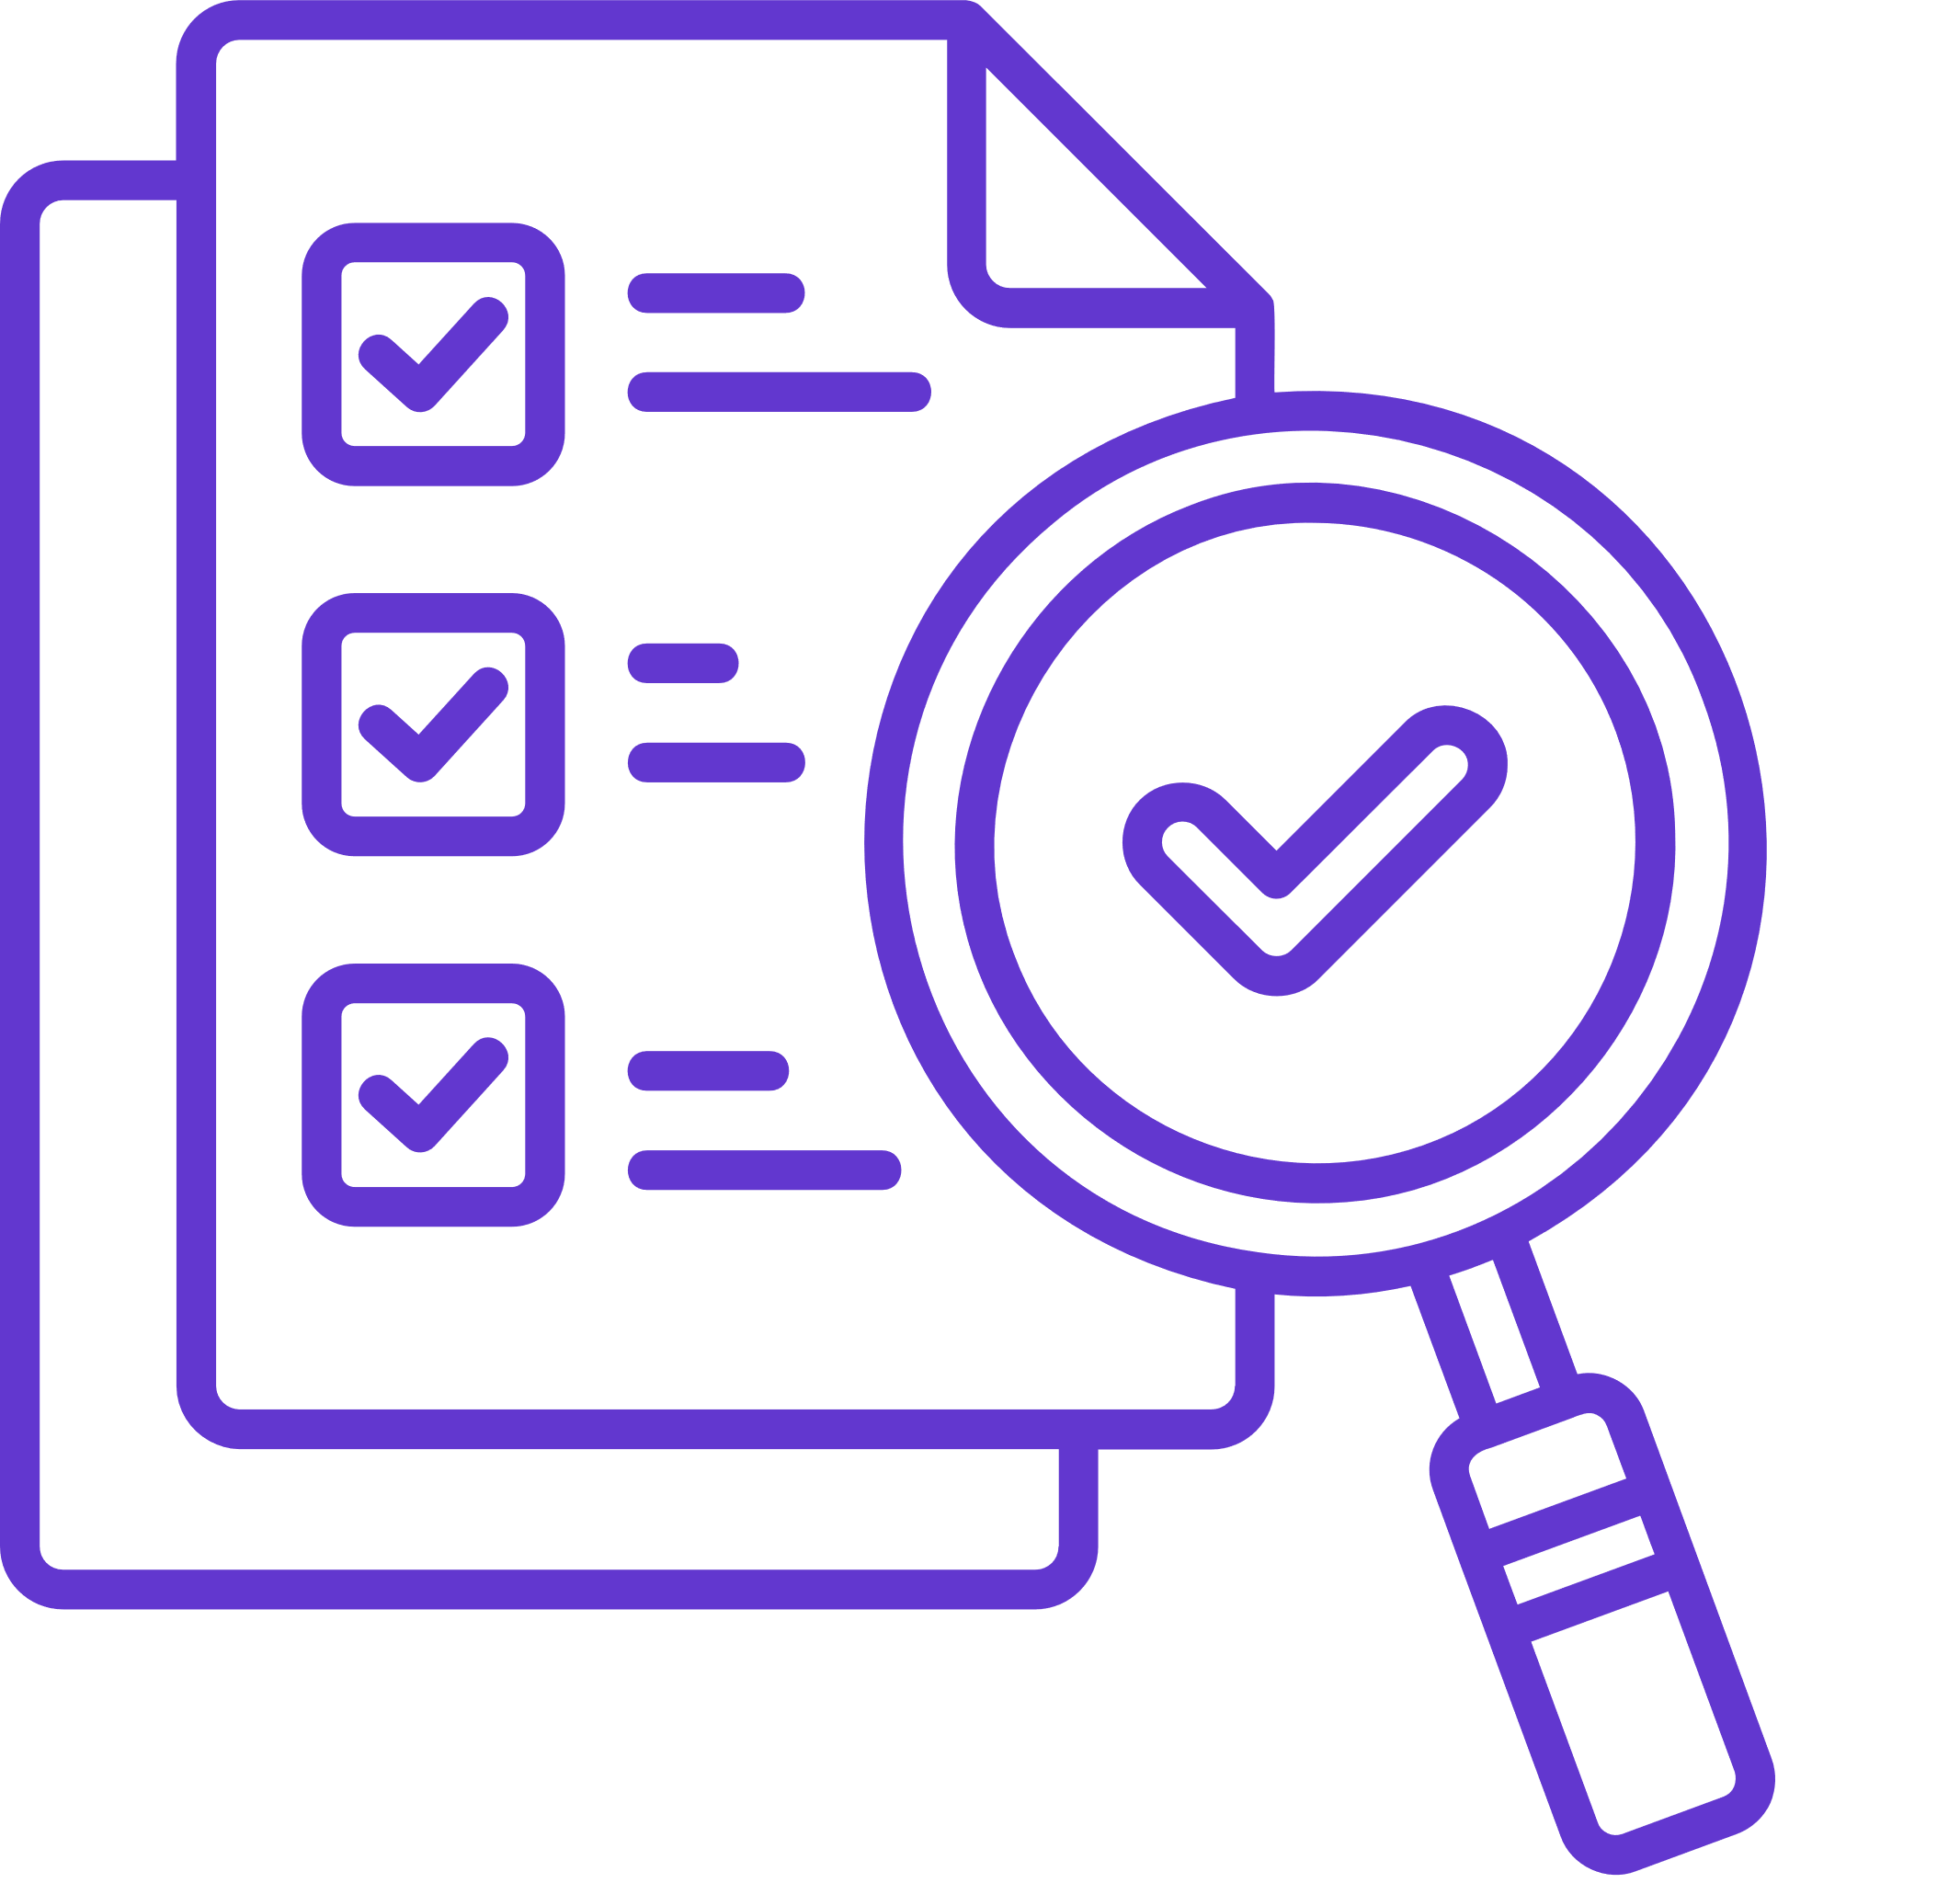
Challenges
Data Quality
Incomplete
Inaccurate
Inconsistent
If customer purchase data is missing for certain months, a system might wrongly assume a customer is inactive.
Garbage in, garbage out — no matter how good the algorithm (K-means, Agglomerative), if data is flawed, segments will be misleading.
For personalization, poor data may lead to irrelevant recommendations or messages.

Slide 11

Challenges
Choosing Relevant Criteria for Segmentation
Demographics
Psychographics
Behavioral
Segmenting based only on age may not reveal shopping preferences as accurately as behavioral data.
Which variable or combination gives the most useful, actionable segments?
Over-simplified criteria may miss key nuances, while too many variables can make clusters hard to interpret.

Slide 12

Challenges
Privacy
Consent
Transparency
Compliance
A recommendation system that uses private location history without consent might violate user privacy and spark backlash.
Failing to handle data responsibly can lead to legal penalties and loss of customer trust.
Limits access to certain kinds of rich, personalized data.

Slide 13
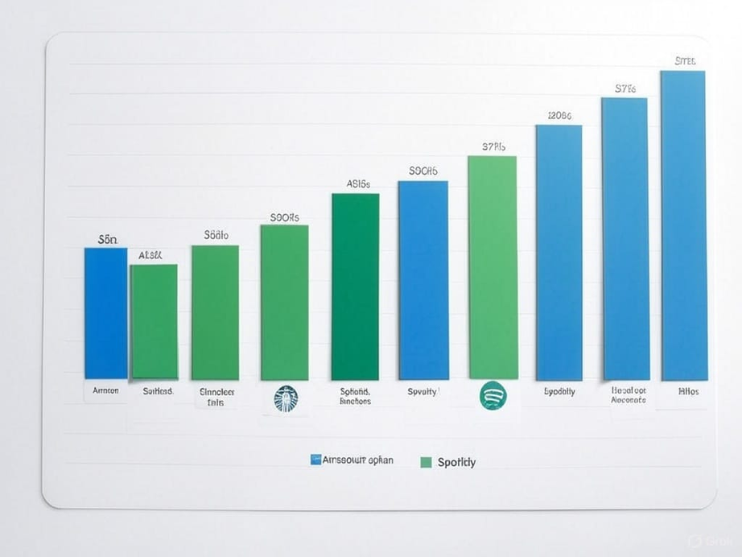
Real World applications
POWERING BUSINESS GROWTH WITH ML-DRIVEN INSIGHTS
Business Value:
Engagement: Personalized recommendations boost user interaction (e.g., Netflix drives 80% of views via suggestions).
Revenue: Targeted campaigns increase sales (e.g., Amazon’s 35% revenue from personalized product recommendations).
ML-Powered Examples:
Starbucks: Uses K-Means to segment loyalty app users, driving 50% of U.S. sales with tailored offers.
Spotify: Recommendation systems personalize playlists, enhancing user retention by 20%.
Why It Works: K-Means, agglomerative clustering, and recommendation systems uncover actionable customer insights.

Slide 14
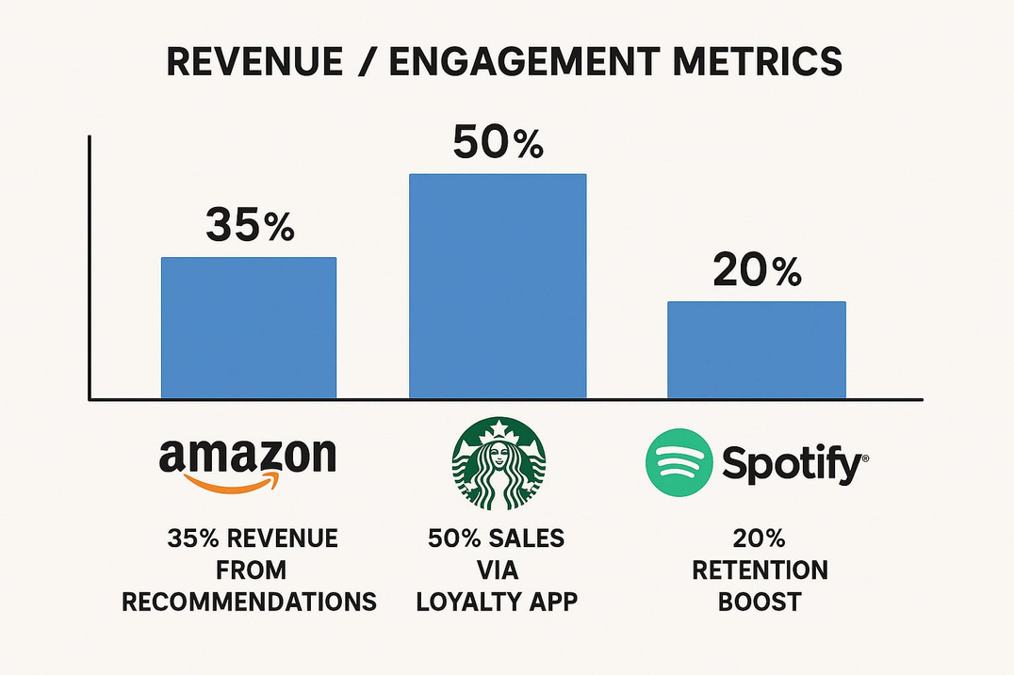
Real World applications
SHAPING THE FUTURE OF PERSONALIZATION WITH MACHINE LEARNING
Key Takeaway: ML-driven segmentation and personalization revolutionize customer experiences, enhancing loyalty and profitability.
Cross-Industry Impact:
E-Commerce: Amazon uses hybrid recommendation models, combining collaborative and content-based filtering for precision.
Streaming: Spotify applies agglomerative clustering to group users by listening habits, tailoring playlists dynamically.
Retail: Starbucks leverages K-Means to identify high-value customers, optimizing marketing spend.
Future Trends: Deep learning enables real-time hyper-personalization; privacy-first approaches (e.g., zero-party data) ensure ethical AI practices.

Slide 15
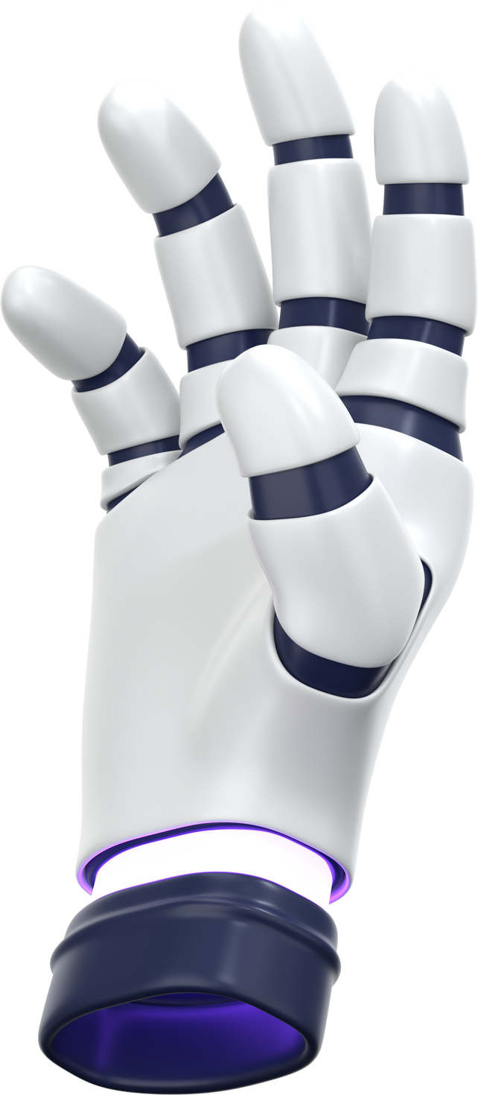
Thank You.

